Slide 1
Lab session – II
Data types, variables

Slide 2
Integral Data types, Min and Max Value
Console.WriteLine("Min value of sbyte"+sbyte.MinValue);
Console.WriteLine("Max value of sbyte" + sbyte.MaxValue);
Console.WriteLine("Min value of short" + short.MinValue);
Console.WriteLine("Max value of short" + short.MaxValue);
Console.WriteLine("Min value of ushort" + ushort.MinValue);
Console.WriteLine("Max value of ushort" + sbyte.MaxValue);
Console.WriteLine("Min value of int" + int.MinValue);
Console.WriteLine("Max value of int" + int.MaxValue);

Slide 3
Integral Data types, Min and Max Value
Console.WriteLine("Min value of uint" + uint.MinValue);
Console.WriteLine("Max value of uint" + uint.MaxValue);
Console.WriteLine("Min value of long" + long.MinValue);
Console.WriteLine("Max value of long" + long.MaxValue);
Console.WriteLine("Min value of ulong" + ulong.MinValue);
Console.WriteLine("Min value of ulong" + ulong.MaxValue);

Slide 4
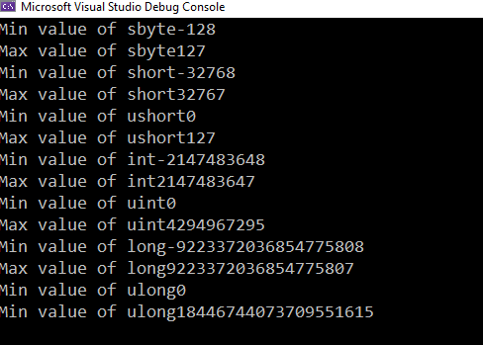
Results of the execution of the above codes

Slide 5
Declaration of built in data types
int age = 30;
double gpa = 3.7;
float height = 1.95f;
decimal balance = 12500000000000m;

Slide 6
Exercise: debugging
Which of the following lines of code results in an error? And how should it be fixed?
float floatPI = 3.142589663144789965522336654789;
double doublePI = 3.142589663144789965522336654789;
decimal decimalPI = 3.142589663144789965522336654789;

Slide 7
Exercise
Write a C# Sharp program that takes the radius of a sphere as input and calculate and display the volume of the sphere.
Write a C# Sharp program to accept two integers and check whether they are equal or not.
Write a C# Sharp program to read the age of a candidate and determine whether it is eligible for casting his/her own vote.
Write a C# Sharp program that takes a character as input and check the input (lowercase) is a vowel, a digit, a space or a special character.
Write a C# Sharp program that takes two numbers as input and returns true or false when both numbers are even or odd.

Slide 8
Write a C# Sharp program to accept the height of a person in centimeter and categorize the person according to their height.
<1.5m
1.5m – 1.65m average
1.66m – 1.95m tall
>1.95m – very tall
Write a C# Sharp program to find the largest of three numbers

Slide 9
Exercise : Loops
Write a program to print the following patterns
(1,1 )(1,2 )(1,3 )(2,1 )(2,2 )(2,3 )(3,1 )(3,2 )(3,3 )
234
345
***** ***** ***** ***** *****
***** ***** ***** ***** *****
* ** *** **** *****

